Slide 1


VIKRAM:"Visual Intelligent Kit for Risk Assessment & Monitoring"
VIKRAM is an AI-driven system for early wildfire detection. Combining AI, IoT sensors, and LoRa communication, it enables real-time monitoring and alerts. This system helps protect forests, wildlife, and human settlements.
by Aravind Raj

Slide 2
Objectives of VIKRAM
Early Detection
Real-Time Monitoring
Automated Alerts
Develop an early wildfire detection system using AI and IoT sensors.
Enable real-time monitoring of environmental parameters. This includes temperature, humidity, gas concentration, and smoke.
Provide automated alerts to forest officials and emergency response teams.

Slide 3
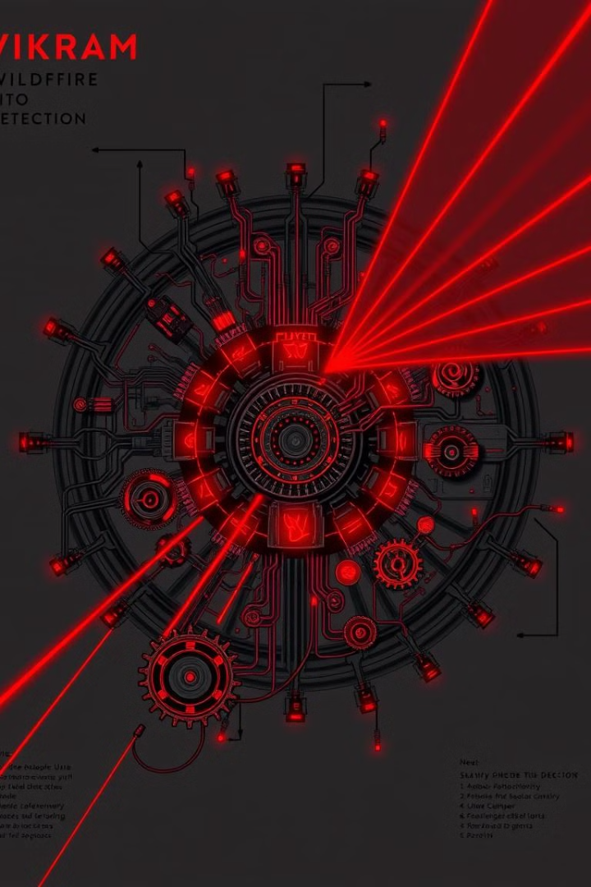



Key System Components
DHT22 Sensor
Pi Camera
LoRa Module
Captures images for AI-based smoke and fire analysis.
Enables long-range wireless communication.
Measures temperature and humidity variations effectively.

Slide 4
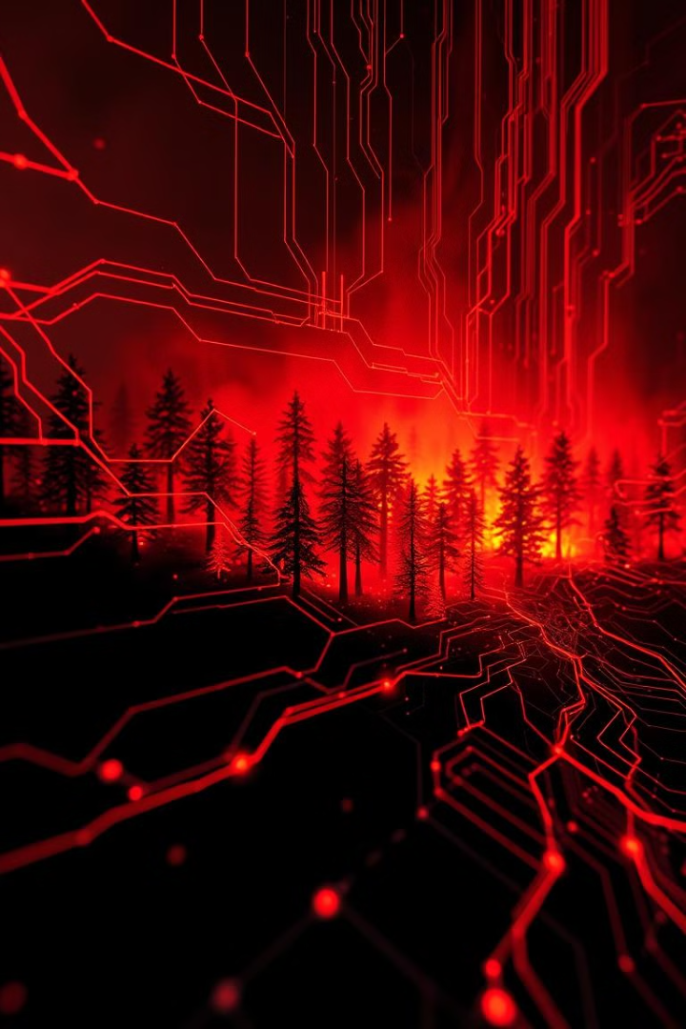




AI-Based Analysis Methodology
Data Collection
Collect environmental data and image/video feeds.
AI Analysis
Detect smoke, flames, and anomalies using machine learning.
Edge Processing
Process data locally to reduce latency.
Alerts
Transmit alerts via LoRa to a central station.

Slide 5
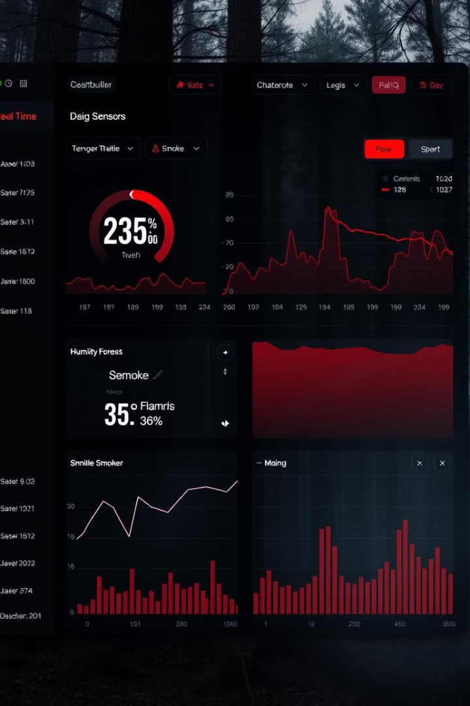
Real-Time Monitoring
1
Continuous Data
Sensors continuously gather data.
2
AI Analysis
AI analyzes data for anomalies.
3
Alerts
Immediate alerts sent upon risk detection.

Slide 6
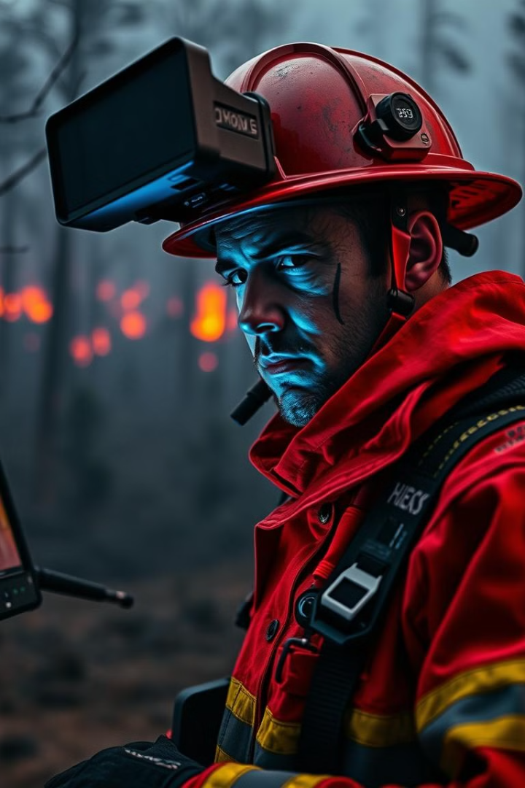
Expected Outcomes
1
Early Detection
2
Reduced False Alarms
Quicker response times to wildfires.
AI-powered analysis minimizes errors.
3
Improved Safety
Enhanced safety for wildlife and communities.

Slide 7
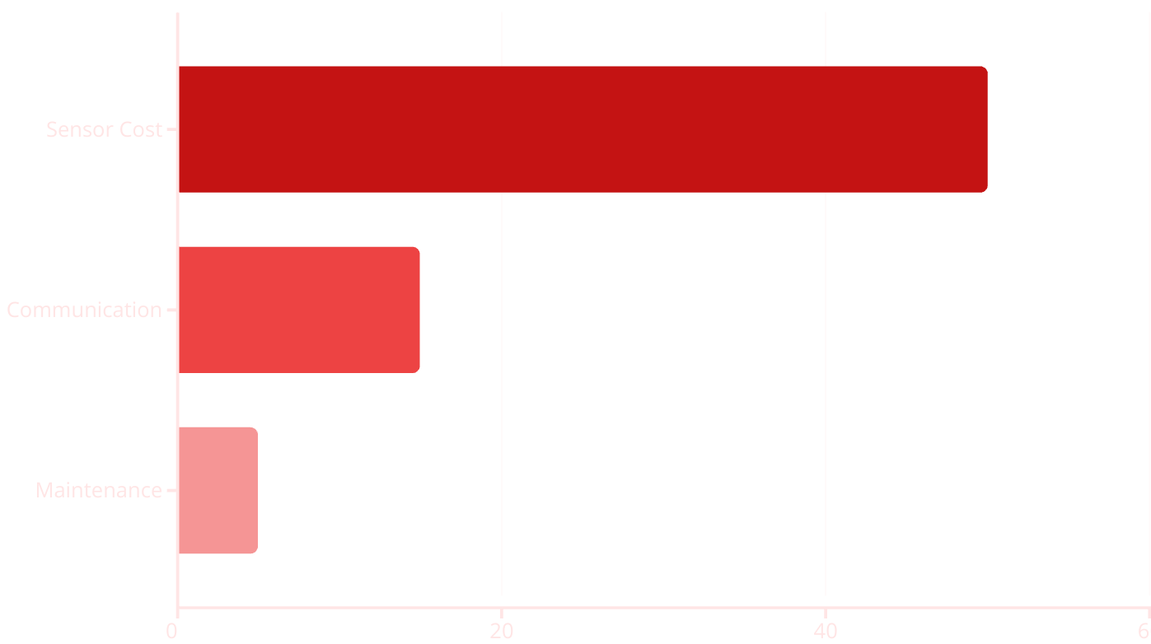
Cost-Effective Solution
Real-time monitoring and long-range communication reduce costs. Scalability achieved using LoRa mesh networks.

Slide 8
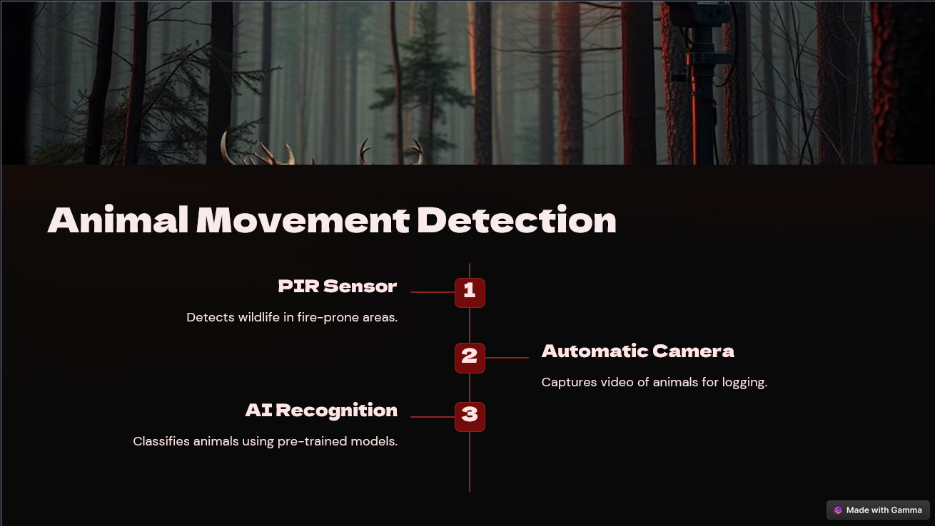

Slide 9
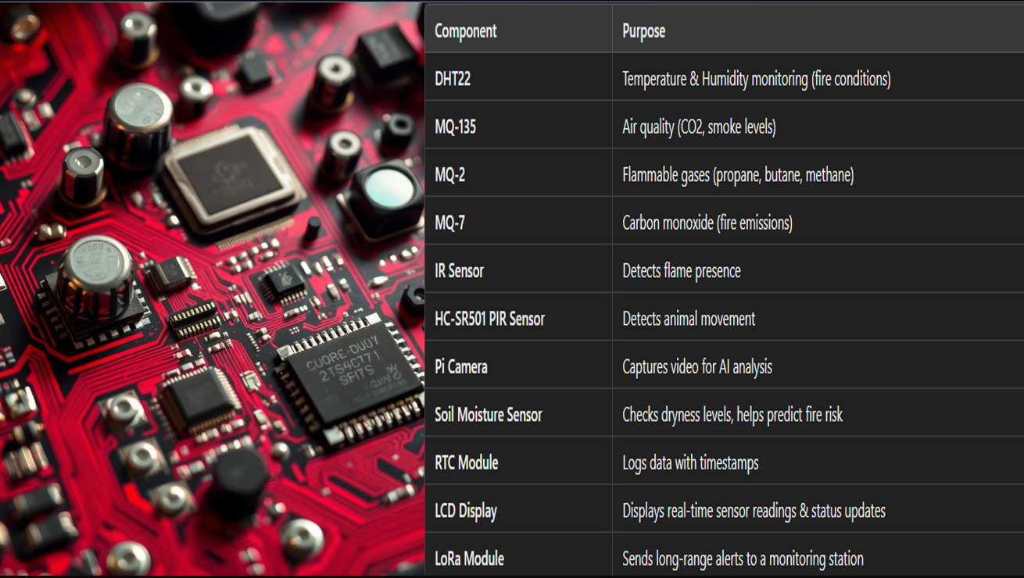

Slide 10
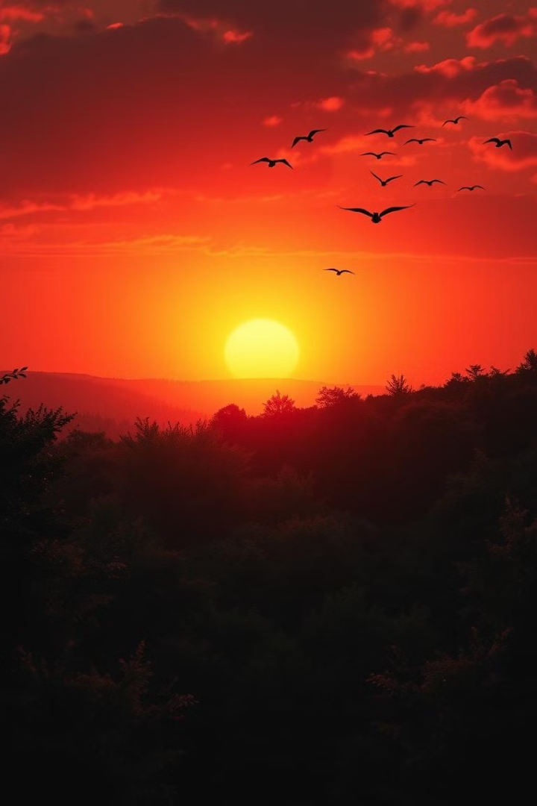
Conclusion: VIKRAM's Impact
VIKRAM offers a groundbreaking approach to wildfire prevention. By combining IoT, AI, and Edge Computing, it offers a scalable, efficient, and cost-effective solution to mitigate forest fires.

Slide 11
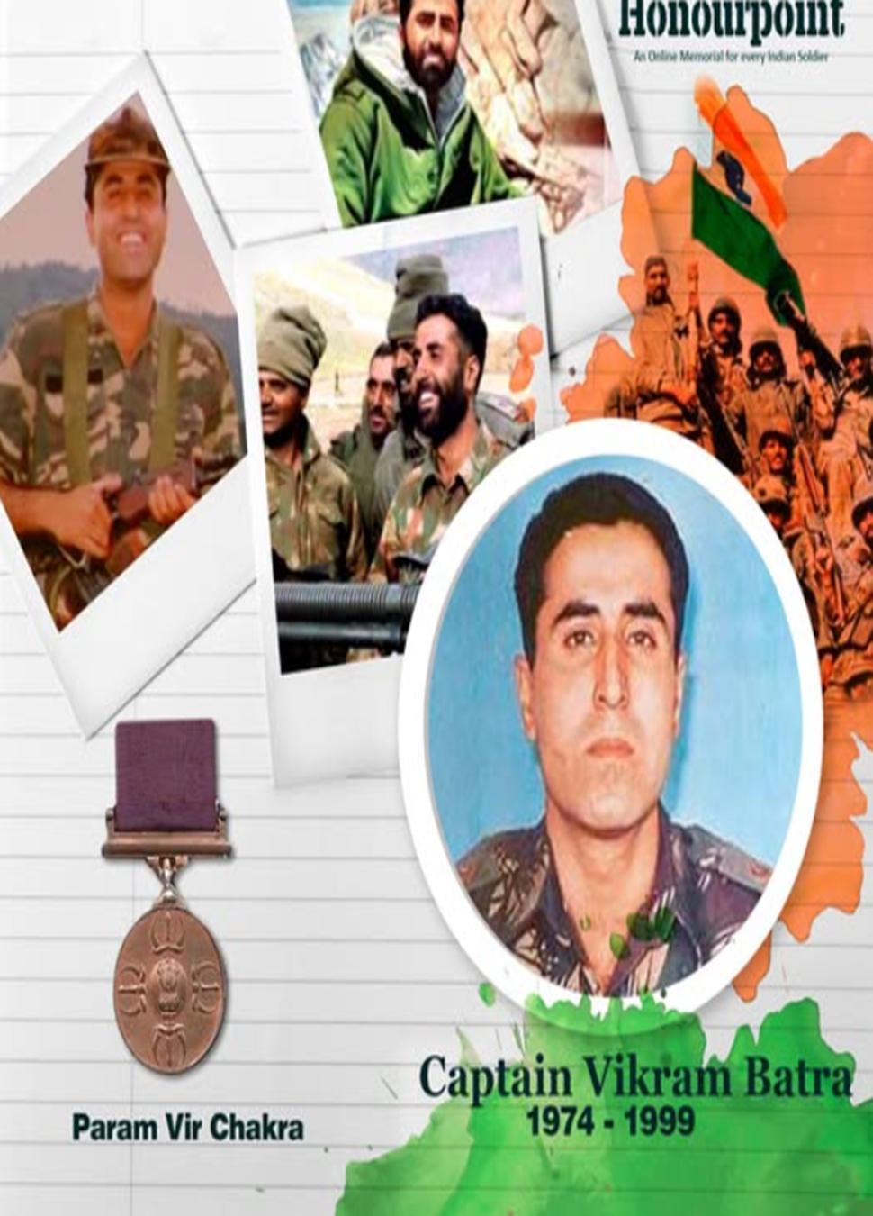
VIKRAM: Honoring Captain Vikram Batra
"Either I will come back after hoisting the Tricolor, or I will come back wrapped in it, but I will come back for sure." – Captain Vikram Batra, PVC
The VIKRAM project is named in honor of Captain Vikram Batra, a true hero of the Kargil War (1999) who made the ultimate sacrifice for the nation. Just as he protected India's borders, this project is dedicated to protecting forests, wildlife, and human lives from the devastating impact of wildfires.
"Service Before Self"—A Legacy of Courage, Now in Technology."

